Slide 1
CRI3I3 Pemrograman Perangkat Bergerak
Layout (1)

Slide 2
Outline
Widget
Container
Row & Column
ListView
GridView
Stack

Slide 3
Widget
Widgets describe what their view should look like given their current configuration and state, that is inspired from React
If a widget’s state changes, the widget rebuilds its description, which the framework diffs against the previous description in order to determine the minimal changes needed in the underlying render tree to transition from one state to the next

Slide 4
Common Basic Widgets
Text
Row, Column
Container
Stack

Slide 5
A Simple Hello World
import 'package:flutter/material.dart';
void main() {
runApp(
const Center(
child: Text(
'Hello, world!',
textDirection: TextDirection.ltr,
),
),
);

Slide 6
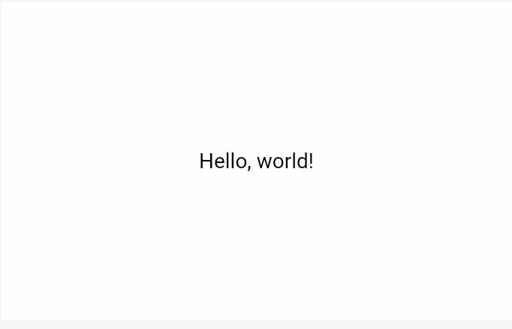
Hello World Output

Slide 7
Container
A convenience widget that combines common painting, positioning, and sizing widgets.
A container first surrounds the child with padding (inflated by any borders present in the decoration) and then applies additional constraints to the padded extent (incorporating the width and height as constraints, if either is non-null). The container is then surrounded by additional empty space described from the margin.

Slide 8
Container Class
The Container widget is used to contain a child widget with the ability to apply some styling properties.
If the Container widget has no child it will automatically fill the given area on the screen, otherwise it will wrap the height & width of the given child element.

Slide 9
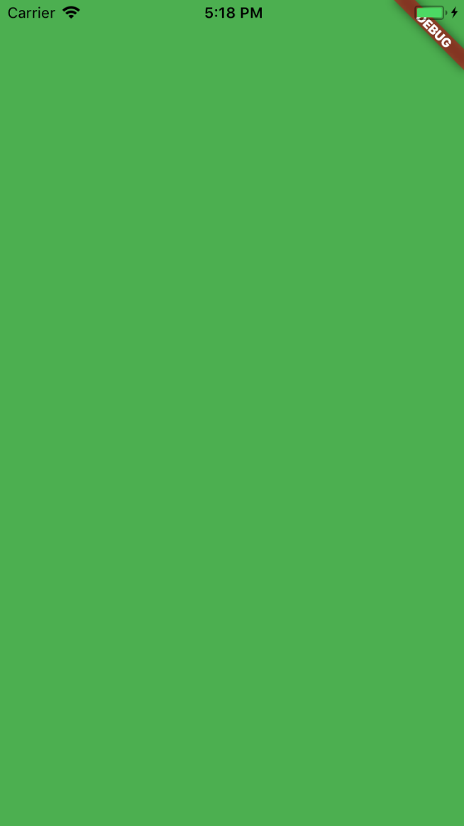
Color Property
Center(
child: Container(
color: Colors.green,
),
);

Slide 10
Colors Class
Use Colors Class with the color name:
color: Colors.green
Use Colors Class with added shade:
color: Colors.green[400]
OR
color: Colors.green.shade400
Use Colors Class with hexa:
Color(0xFFFFFF)
Color.fromARGB(0xFF, 0x42, 0xA5, 0xF5);

Slide 11
Container - Child Property
Provide a child widget to be contained by the container, the container will wrap the width & height of this child
This widget can only have one child. To lay out multiple children, let this widget’s child be a widget such as Row, Column, or Stack, which have a children property, and then provide the children to that widget (will be discussed later)

Slide 12
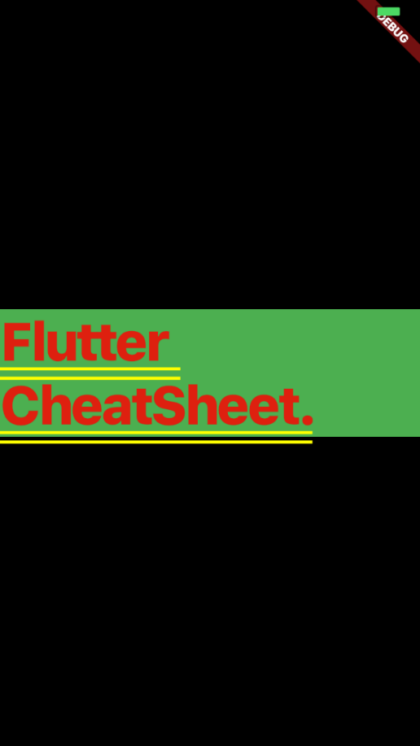
Child Property
Center(
child: Container(
color: Colors.green,
child: Text("Flutter CheatSheet."),
),
);

Slide 13
Container - Alignment Property
Alignment property is applied to align the child widgets
Alignment take 2 parameters x and y
Alignment(0.0, 0.0) represents the center of the rectangle

Slide 14
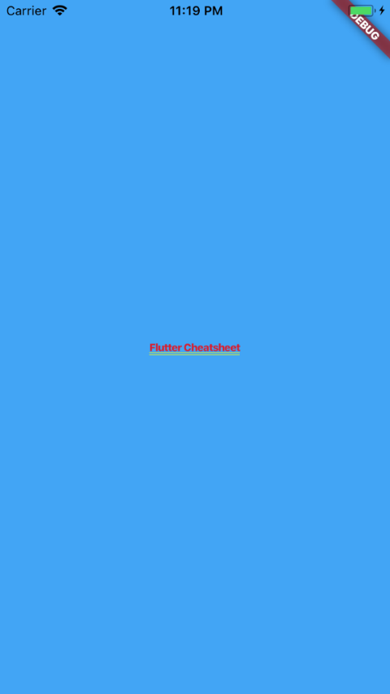
Child Property
Center(
child: Container(
color: Color.fromARGB(255, 66, 165, 245),
child: new Text("Flutter Cheatsheet",
style: TextStyle(
fontSize: 10.0
),
),
alignment: Alignment(0.0, 0.0),
),
);

Slide 15
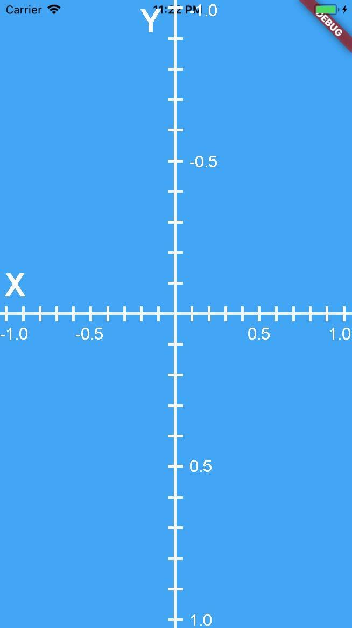
Alignment X and Y
Constants
Alignment.bottomCenter OR Alignment(0.0, 1.0)
Alignment.bottomLeft OR Alignment(-1.0, 1.0)
etc.

Slide 16
FractionalOffset
FractionalOffset and Alignment are two different representations of the same information: the location within a rectangle relative to the size of the rectangle. The difference between the two classes is in the coordinate system they use to represent the location.
FractionalOffset uses a coordinate system with an origin in the top-left corner of the rectangle whereas Alignment uses a coordinate system with an origin in the center of the rectangle.

Slide 17
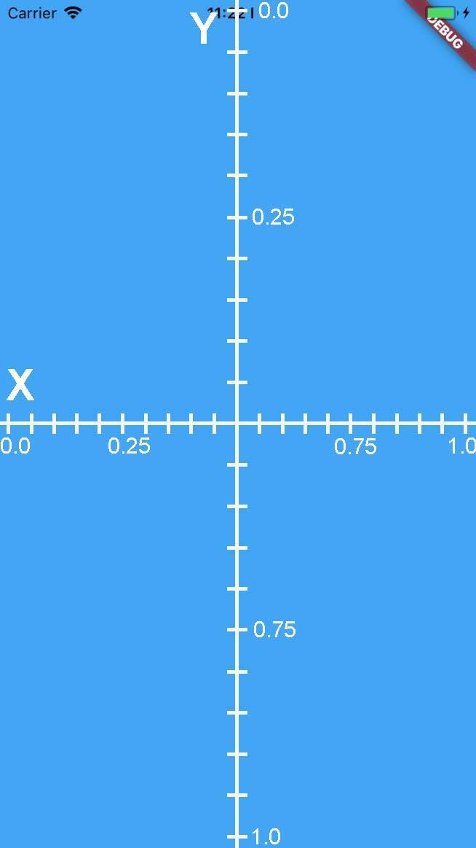
FractionalOffset Coordinate

Slide 18
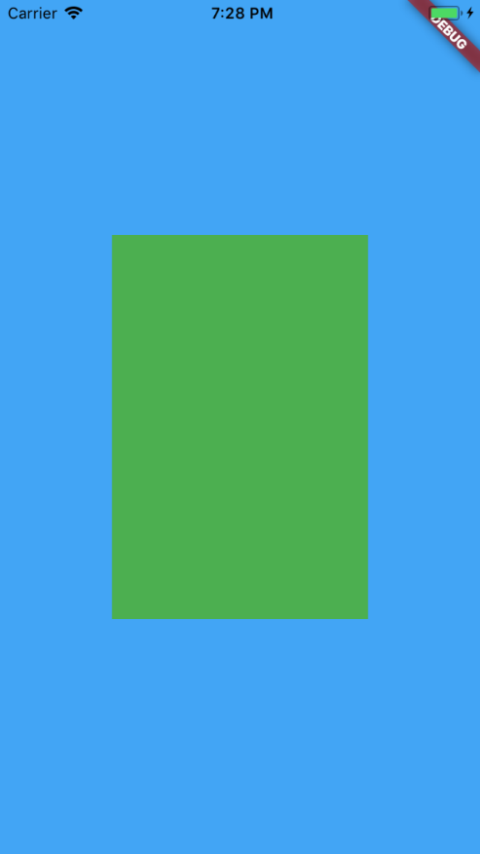
Container - Constraints Property
Center(
child: Container(
color: Color.fromARGB(255, 66, 165, 245),
alignment: AlignmentDirectional(0.0, 0.0),
child: Container(
color: Colors.green,
constraints: BoxConstraints(
maxHeight: 300.0,
maxWidth: 200.0,
minWidth: 150.0,
minHeight: 150.0
),
),
),
);

Slide 19
Container - Margin Property
A margin is just a property specifying to add empty space to surround of the container using an EdgeInsets constant value.
EdgeInsets.all(20.0)
EdgeInsets.symmetric(vertical: 20.0, horizontal: 50.0)
EdgeInsets.fromLTRB(20.0, 30.0, 40.0, 50.0)
EdgeInsets.only( left: 20.0, bottom: 40.0, top: 50.0 )

Slide 20
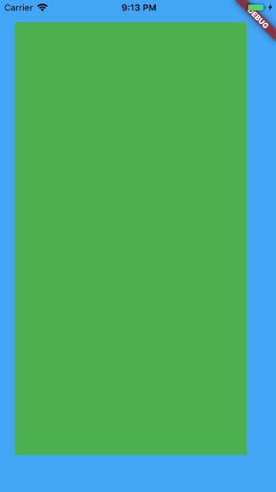
Container - Constraints Property
Center(
child: Container(
color: Color.fromARGB(255, 66, 165, 245),
alignment: AlignmentDirectional(0.0, 0.0),
child: Container(
color: Colors.green,
margin: new EdgeInsets.fromLTRB(20.0, 30.0, 40.0, 50.0),
),
),
);

Slide 21
Container - Padding Property
A padding is just a property specifying to add empty space to inscribe inside the container using an EdgeInsets constant value same as the margin.

Slide 22
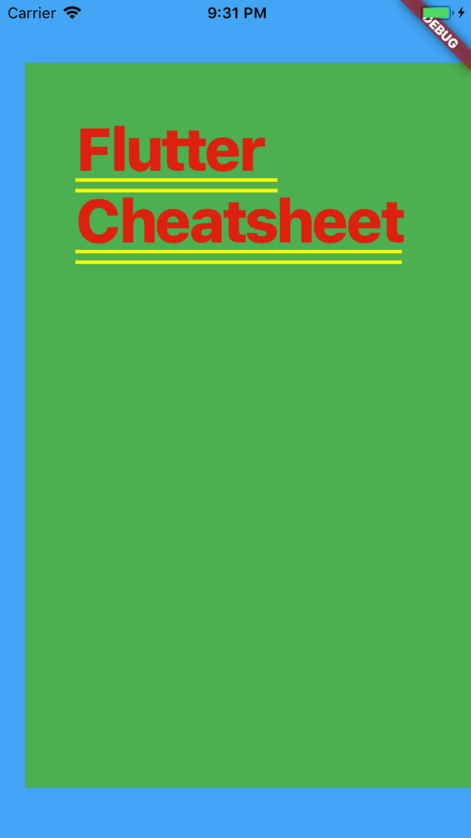
Container - Constraints Property
Center(
child: Container(
color: Color.fromARGB(255, 66, 165, 245),
alignment: AlignmentDirectional(0.0, 0.0),
child: Container(
margin: new EdgeInsets.only(
left: 20.0,
bottom: 40.0,
top: 50.0
),
padding: new EdgeInsets.all(40.0),
color: Colors.green,
child: Text("Flutter Cheatsheet"),
constraints: BoxConstraints.expand(),
),
),
);

Slide 23
Container - Decoration Property
A decoration property can be applied behind the given container.
The value can be:
BoxDecoration Class
FlutterLogoDecoration Class
ShapeDecoration Class
UnderlineTabIndicator Class

Slide 24
Container - ForegroundDecoration
A decoration property can be applied in front of the given container.
The value options are the same Decoration

Slide 25
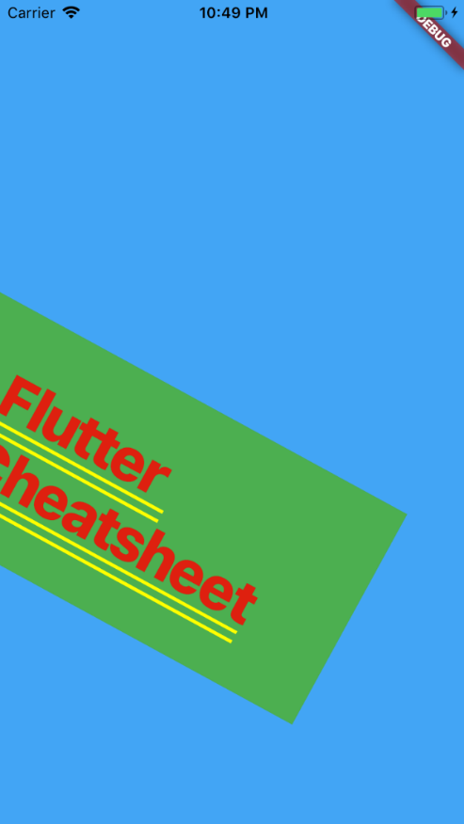
Container - Transform Property
Center(
child: Container(
color: Color.fromARGB(255, 66, 165, 245),
alignment: AlignmentDirectional(0.0, 0.0),
child: Container(
padding: new EdgeInsets.all(40.0),
color: Colors.green,
child: Text("Flutter Cheatsheet"),
transform: new Matrix4.rotationZ(0.5)
),
),
);

Slide 26
Row Class
A widget that displays its children in a horizontal array.
To cause a child to expand to fill the available horizontal space, wrap the child in an Expanded widget.
The Row widget does not scroll (and in general it is considered an error to have more children in a Row than will fit in the available room).

Slide 27
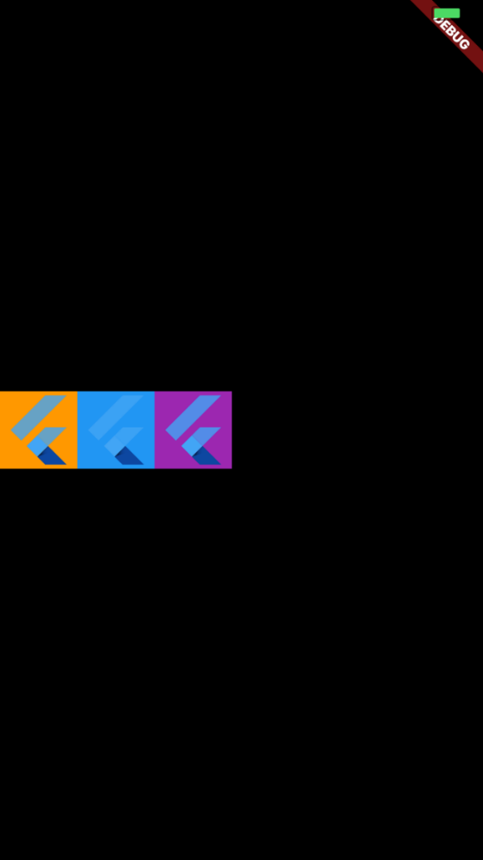
Row Example
Row(
children: [
Container(
color: Colors.orange,
child: FlutterLogo(
size: 60.0,
),
),
Container(
color: Colors.blue,
child: FlutterLogo(
size: 60.0,
),
),
Container(
color: Colors.purple,
child: FlutterLogo(
size: 60.0,
),
),
],
)

Slide 28
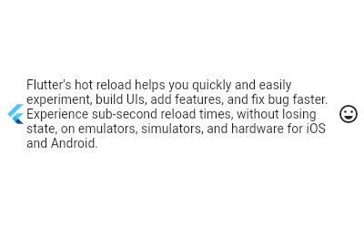
Row with Expanded
Row(
children: <Widget>[
const FlutterLogo(),
const Expanded(
child: Text("Flutter's hot reload helps you quickly and easily experiment, build UIs, add features, and fix bug faster. Experience sub-second reload times, without losing state, on emulators, simulators, and hardware for iOS and Android."),
),
const Icon(Icons.sentiment_very_satisfied),
],
)

Slide 29
Column Class
A widget that displays its children in a vertical array.
To cause a child to expand to fill the available vertical space, wrap the child in an Expanded widget.
The Column widget does not scroll (and in general it is considered an error to have more children in a Column than will fit in the available room).

Slide 30
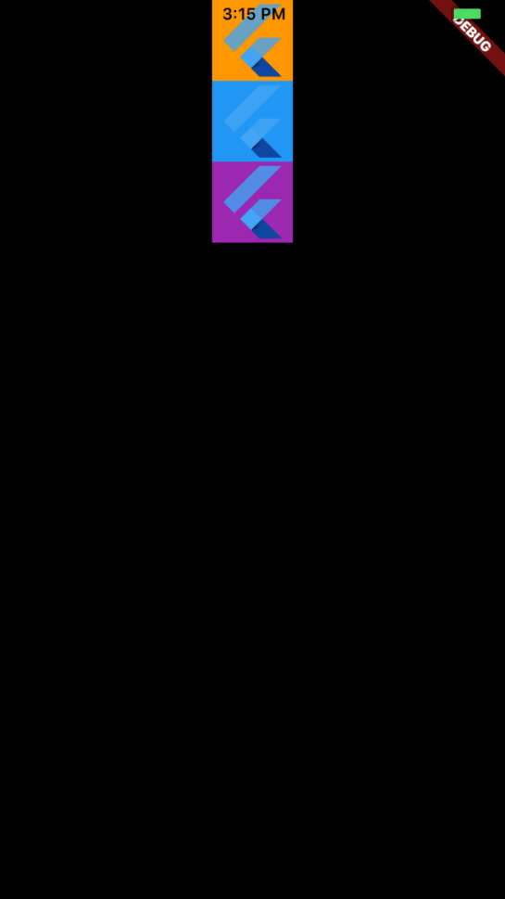
Column Example
Column(
children: [
Container(
color: Colors.orange,
child: FlutterLogo(
size: 60.0,
),
),
Container(
color: Colors.blue,
child: FlutterLogo(
size: 60.0,
),
),
Container(
color: Colors.purple,
child: FlutterLogo(
size: 60.0,
),
),
],
)

Slide 31
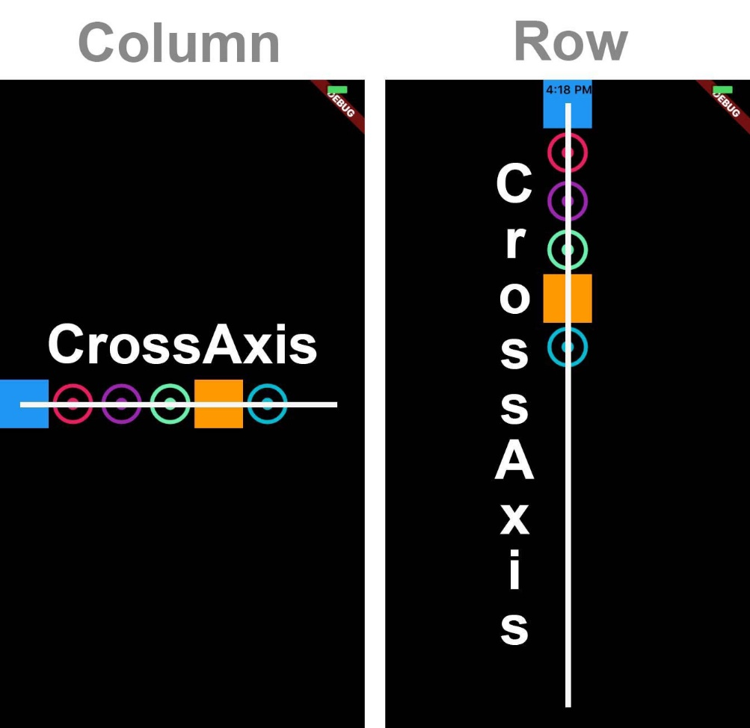
CrossAxis in Row and Column

Slide 32
CrossAxisAlignment Propery
We can use the crossAxisAlignment property to align our child widget in the desired direction, for example:
crossAxisAlignment.start would place the children with their start edge aligned with the start side of the cross axis
CrossAxisAlignment.center would place the children so that their centers align with the middle of the cross axis.
Others:
CrossAxisAlignment.end
CrossAxisAlignment.stretch
CrossAxisAlignment.baseline

Slide 33
TextDirection Propery
Determines the order to lay children out horizontally and how to interpret start and end in the horizontal direction.
textDirection: TextDirection.rtl
textDirection: TextDirection.ltr

Slide 34
VerticalDirection Property
Determines the order to lay children out vertically and how to interpret start and end in the vertical direction.
VerticalDirection.down
VerticalDirection.up

Slide 35
MainAxisAlignment Property
The positioning of the child widgets on the main axis.
MainAxisAlignment.start
MainAxisAlignment.center
MainAxisAlignment.end
MainAxisAlignment.spaceAround
MainAxisAlignment.spaceBetween
MainAxisAlignment.spaceEvenly

Slide 36
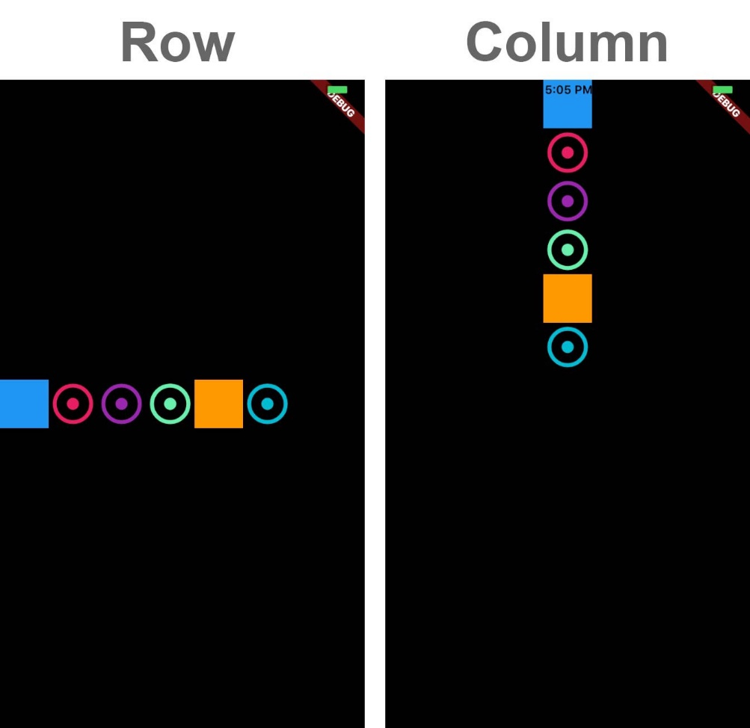
MainAxisAlignment.start

Slide 37
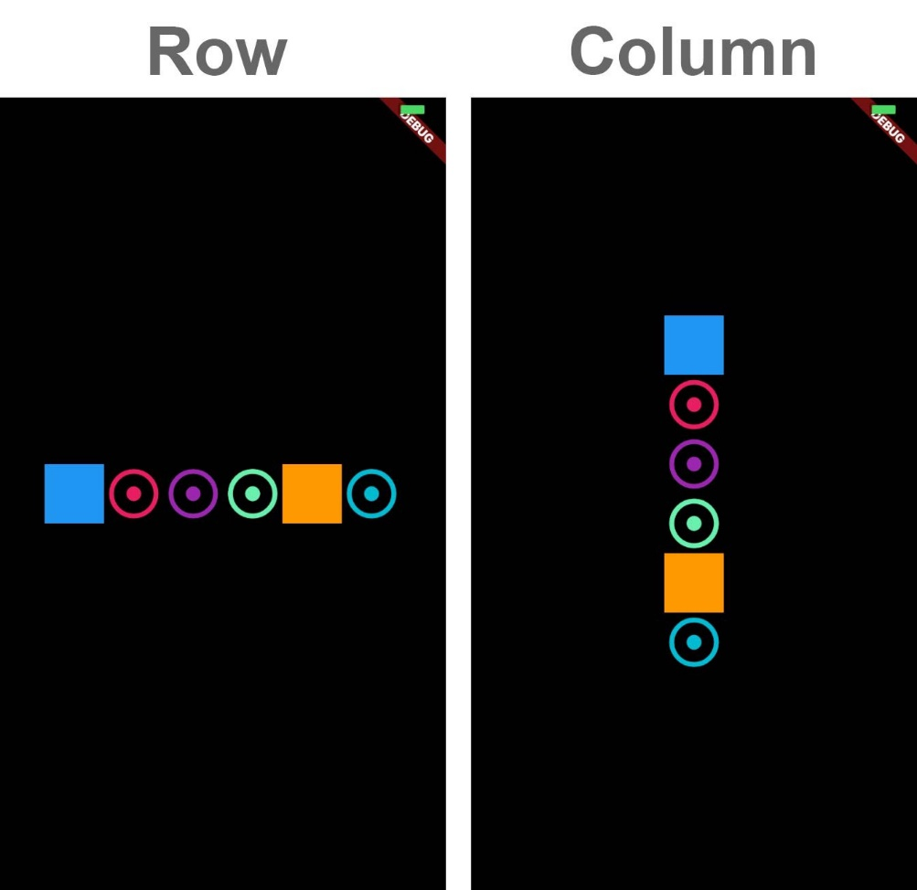
MainAxisAlignment.center

Slide 38
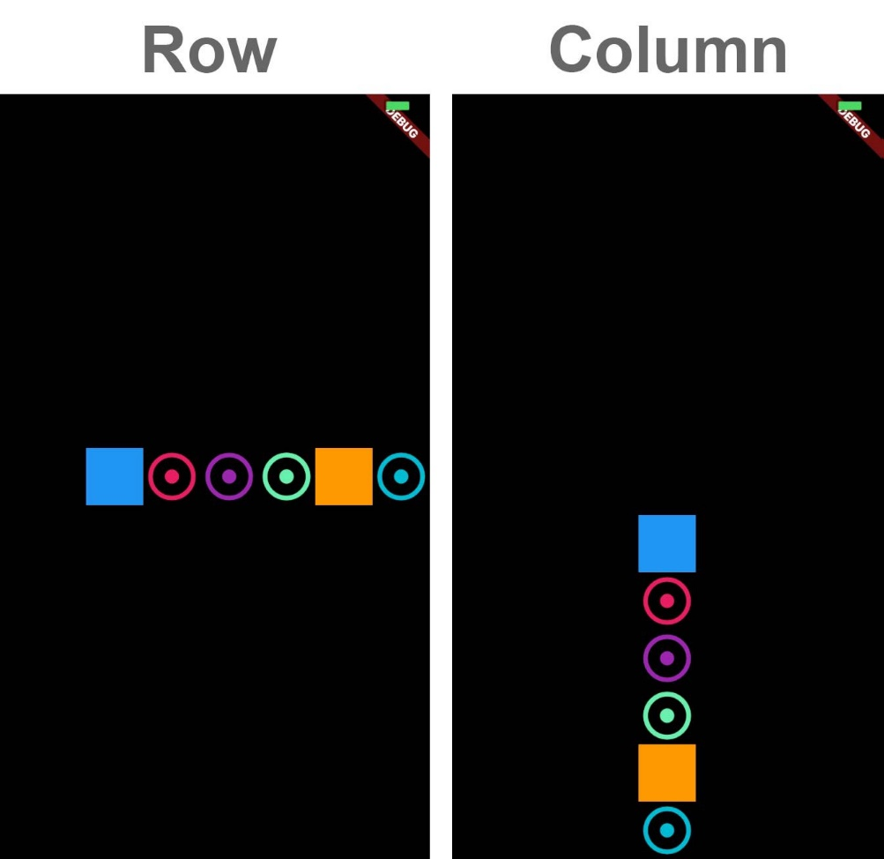
MainAxisAlignment.end

Slide 39
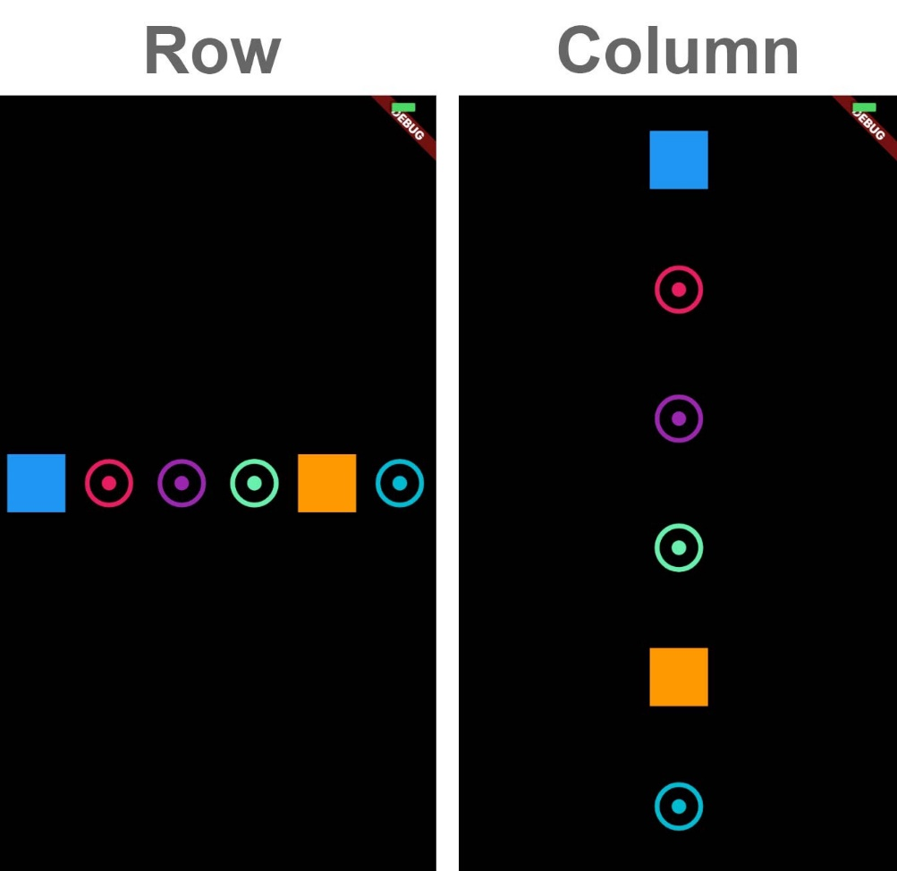
MainAxisAlignment.spaceAround

Slide 40
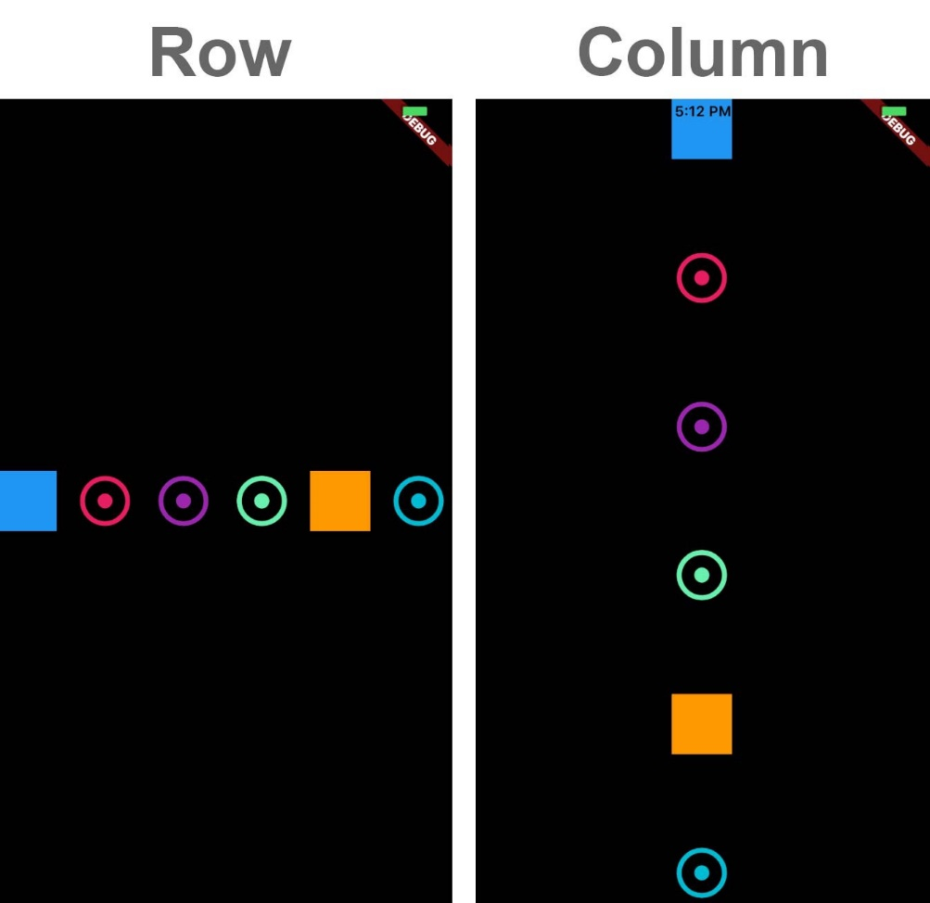
MainAxisAlignment.spaceBetween

Slide 41
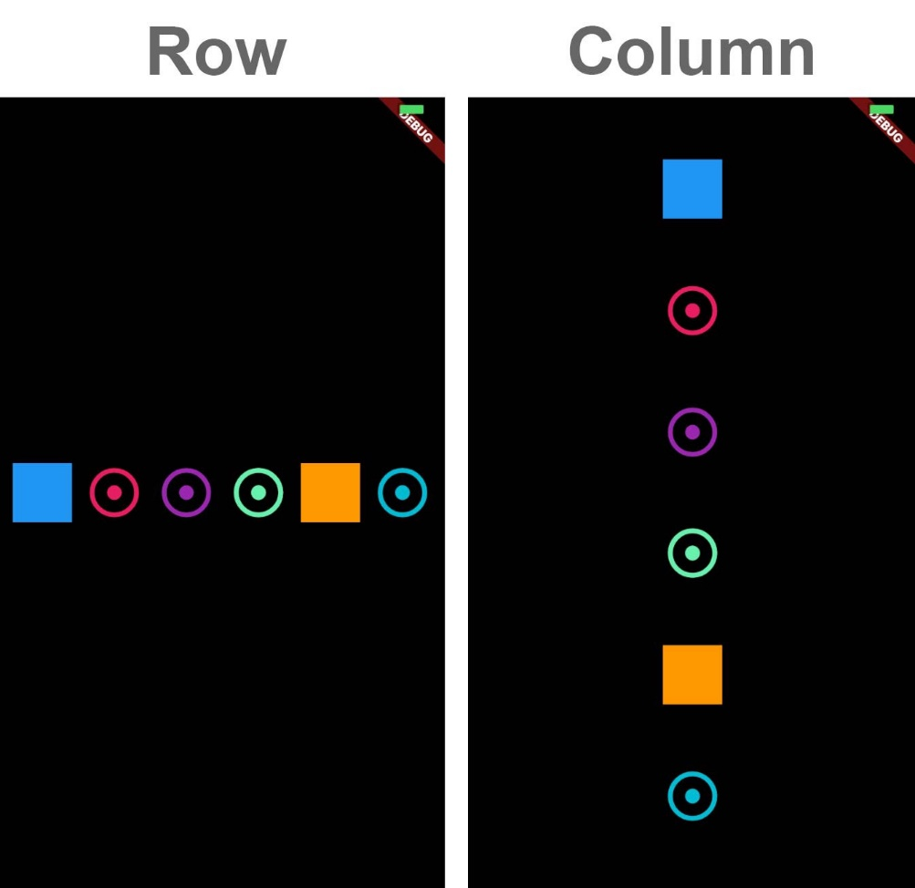
MainAxisAlignment.spaceEvenly

Slide 42
MainAxisSize Property
The size that should be allocated to the widget on the main axis.
MainAxisSize.max
MainAxisSize.min

Slide 43
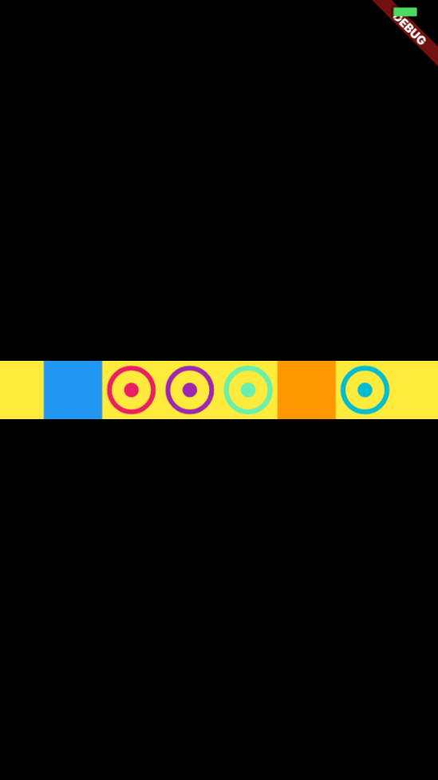
MainAxisSize.max

Slide 44
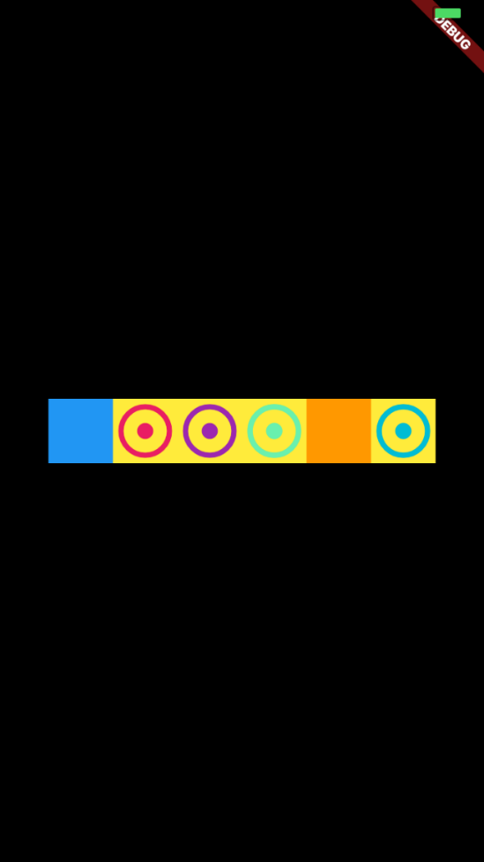
MainAxisSize.min

Slide 45
ListView Class
A scrollable list of widgets arranged linearly.
ListView is the most commonly used scrolling widget. It displays its children one after another in the scroll direction. In the cross axis, the children are required to fill the ListView.
If non-null, the itemExtent forces the children to have the given extent in the scroll direction.
If non-null, the prototypeItem forces the children to have the same extent as the given widget in the scroll direction.

Slide 46
Four Options to Construct a ListView (1)
The default constructor takes an explicit List<Widget> of children.
The ListView.builder constructor takes an IndexedWidgetBuilder, which builds the children on demand.

Slide 47
Four Options to Construct a ListView (1)
The ListView.separated constructor takes two IndexedWidgetBuilders: itemBuilder builds child items on demand, and separatorBuilder similarly builds separator children which appear in between the child items.
The ListView.custom constructor takes a SliverChildDelegate, which provides the ability to customize additional aspects of the child model.

Slide 48
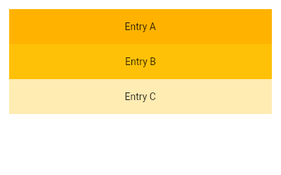
ListView Example (1)
ListView(
padding: const EdgeInsets.all(8),
children: <Widget>[
Container(
height: 50,
color: Colors.amber[600],
child: const Center(child: Text('Entry A')),
),
Container(
height: 50,
color: Colors.amber[500],
child: const Center(child: Text('Entry B')),
),
Container(
height: 50,
color: Colors.amber[100],
child: const Center(child: Text('Entry C')),
),
],
)

Slide 49
ListView Example (2)
final List<String> entries = <String>['A', 'B', 'C'];
final List<int> colorCodes = <int>[600, 500, 100];
ListView.builder(
padding: const EdgeInsets.all(8),
itemCount: entries.length,
itemBuilder: (BuildContext context, int index) {
return Container(
height: 50,
color: Colors.amber[colorCodes[index]],
child: Center(child: Text('Entry ${entries[index]}')),
);
}
);

Slide 50
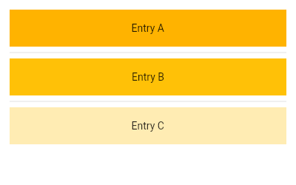
ListView Example (3)
final List<String> entries = <String>['A', 'B', 'C'];
final List<int> colorCodes = <int>[600, 500, 100];
ListView.separated(
padding: const EdgeInsets.all(8),
itemCount: entries.length,
itemBuilder: (BuildContext context, int index) {
return Container(
height: 50,
color: Colors.amber[colorCodes[index]],
child: Center(child: Text('Entry ${entries[index]}')),
);
},
separatorBuilder: (BuildContext context, int index) => const Divider(),
);

Slide 51
GridView Class
The main axis direction of a grid is the direction in which it scrolls (the scrollDirection).
The most commonly used grid layouts are GridView.count, which creates a layout with a fixed number of tiles in the cross axis, and GridView.extent, which creates a layout with tiles that have a maximum cross-axis extent.

Slide 52
GridView Example (1)
GridView.count(
primary: false,
padding: const EdgeInsets.all(20),
crossAxisSpacing: 10,
mainAxisSpacing: 10,
crossAxisCount: 2,
children: <Widget>[
Container(
padding: const EdgeInsets.all(8),
child: const Text("He'd have you all unravel at the"),
color: Colors.teal[100],
),
Container(
padding: const EdgeInsets.all(8),
child: const Text('Heed not the rabble'),
color: Colors.teal[200],
),
…
],
)

Slide 53
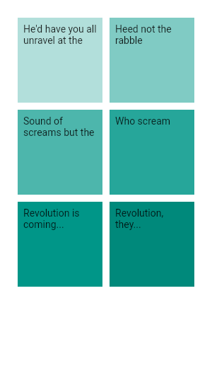
GridView Output

Slide 54
Stack
A widget that positions its children relative to the edges of its box.
This class is useful if you want to overlap several children in a simple way, for example having some text and an image, overlaid with a gradient and a button attached to the bottom.
Each child of a Stack widget is either positioned or non-positioned. Positioned children are those wrapped in a Positioned widget that has at least one non-null property.

Slide 55
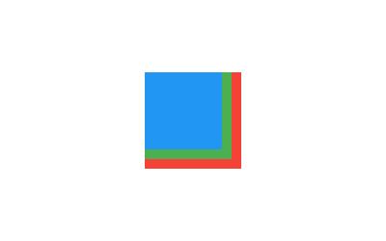
Stack Example (1)
Stack(
children: <Widget>[
Container(
width: 100,
height: 100,
color: Colors.red,
),
Container(
width: 90,
height: 90,
color: Colors.green,
),
Container(
width: 80,
height: 80,
color: Colors.blue,
),
],
)

Slide 56
Stack Example (2)
SizedBox(
width: 250,
height: 250,
child: Stack(
children: <Widget>[
Container(
width: 250,
height: 250,
color: Colors.white,
),
Container(
padding: const EdgeInsets.all(5.0),
alignment: Alignment.bottomCenter,
decoration: BoxDecoration(
gradient: LinearGradient(
begin: Alignment.topCenter,
end: Alignment.bottomCenter,
colors: <Color>[
...
...
Colors.black.withAlpha(0),
Colors.black12,
Colors.black45
],
),
),
child: const Text(
'Foreground Text',
style: TextStyle(color: Colors.white, fontSize: 20.0),
),
),
],
),
)

Slide 57
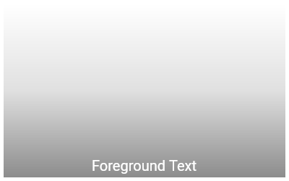
Stack Example (2) Output

Slide 58
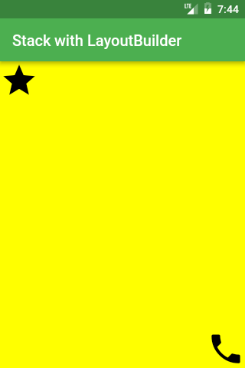
Stack Example (3)
LayoutBuilder(
builder: (context, constraints) =>
Stack(
fit: StackFit.expand,
children: <Widget>[
Material(color: Colors.yellowAccent),
Positioned(
top: 0,
child: Icon(Icons.star, size: iconSize),
),
Positioned(
top: constraints.maxHeight - iconSize,
left: constraints.maxWidth - iconSize,
child: Icon(Icons.call, size: iconSize),
),
],
),
),

Slide 59
References
https://docs.flutter.dev/
https://medium.com/jlouage/container-de5b0d3ad184
https://medium.com/jlouage/flutter-row-column-cheat-sheet-78c38d242041
https://medium.com/flutter-community/flutter-layout-cheat-sheet-5363348d037e

